Slide 1

Coaching and Mentoring
Philmont Training Center
Commissioner Week 2019

Slide 2
Coaching
Philmont Training Center
Commissioner Week 2019
Coaching

Slide 3

Coaching

Slide 4
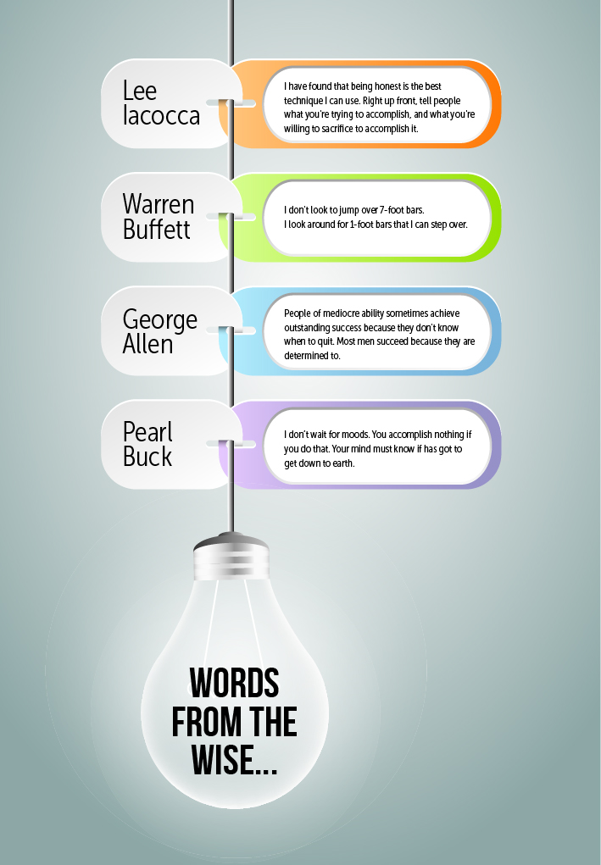
Understanding the Purpose of Coaching
Notes:
Pearl Buck quote I don’t wait for moods. You accomplish nothing if you do that. Your mind must know it has got to get down to earth.

Slide 5

What is Coaching?
WHAT IS COACHING?
Notes:
Ask the class for their thoughts

Slide 6
What is Coaching?
“Coach” Definition:
In the words of Sir John Whitmore: “Unlocking a person’s potential to maximize their own performance. It is helping them to learn rather than teaching them.”

Slide 7
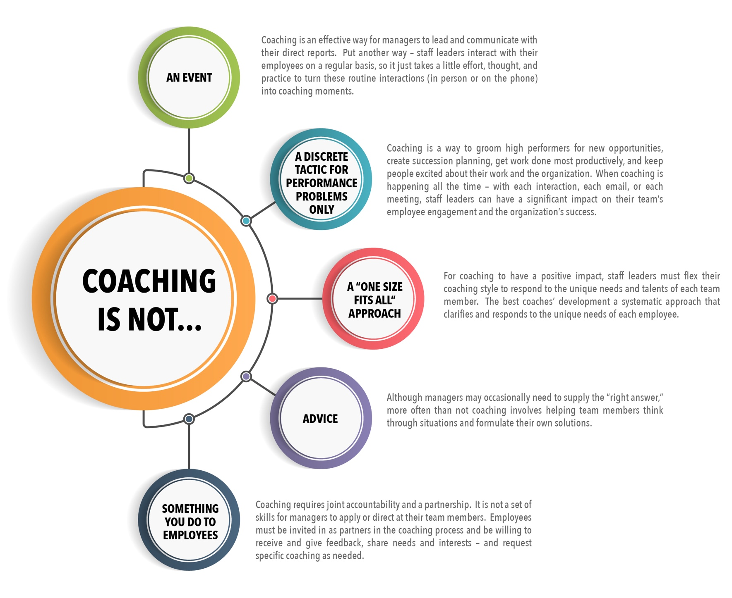
In the workplace……
Can it apply in our volunteer structure?

Slide 8

Coaching and Developing Others
  Key Actions:
    Clarifies performance
    Provides timely feedback
    Conveys performance expectations and implications
    Evaluates skill gaps
    Guides development
    Fosters developmental relationships
Notes:
Coaching and Developing Others: Providing feedback, instruction, and development guidance to help others excel in their current or future job responsibilities; planning and supporting the development of individual skills and abilities.
Key Actions:
Clarifies performance – Seeks information and opinions about an individual’s current performance as well as long-term development needs.
Provides timely feedback – Gives timely, specific and appropriate feedback about performance, development needs, and development progress; reinforces efforts and progress.
Conveys performance expectations and implications—Communicates high expectations; links performance improvement and skill development to important personal and scouting goals; checks for understanding of and commitment to performance and development goals as well as follow-up activities.
Evaluates skill gaps—Diagnoses gaps in knowledge, experience, skills, and behaviors that underlie current and future performance; continually modifies evaluation based on new information.
Guides development – Provides guidance and positive models to help others develop; seeks suggestions for improving performance; collaboratively creates development plans that include activities targeted to specific goals; leverages environmental supports and removes barriers; advocates for individual to reach higher levels of management through developmental opportunities.
Fosters developmental relationships—Helps people feel valued and included in coaching and development discussions by expressing confidence in their ability to excel, maintaining their self-esteem, empathizing, involving them, and disclosing own position.

Slide 9


Coaching, if……..
  Done well, can transfer knowledge on a continuous basis by increasing individual motivation and morale and help individuals/teams deliver outstanding results.
  Done poorly, can waste the time of valuable resources, create a hostile environment and create suboptimal teams and organizations.

Slide 10
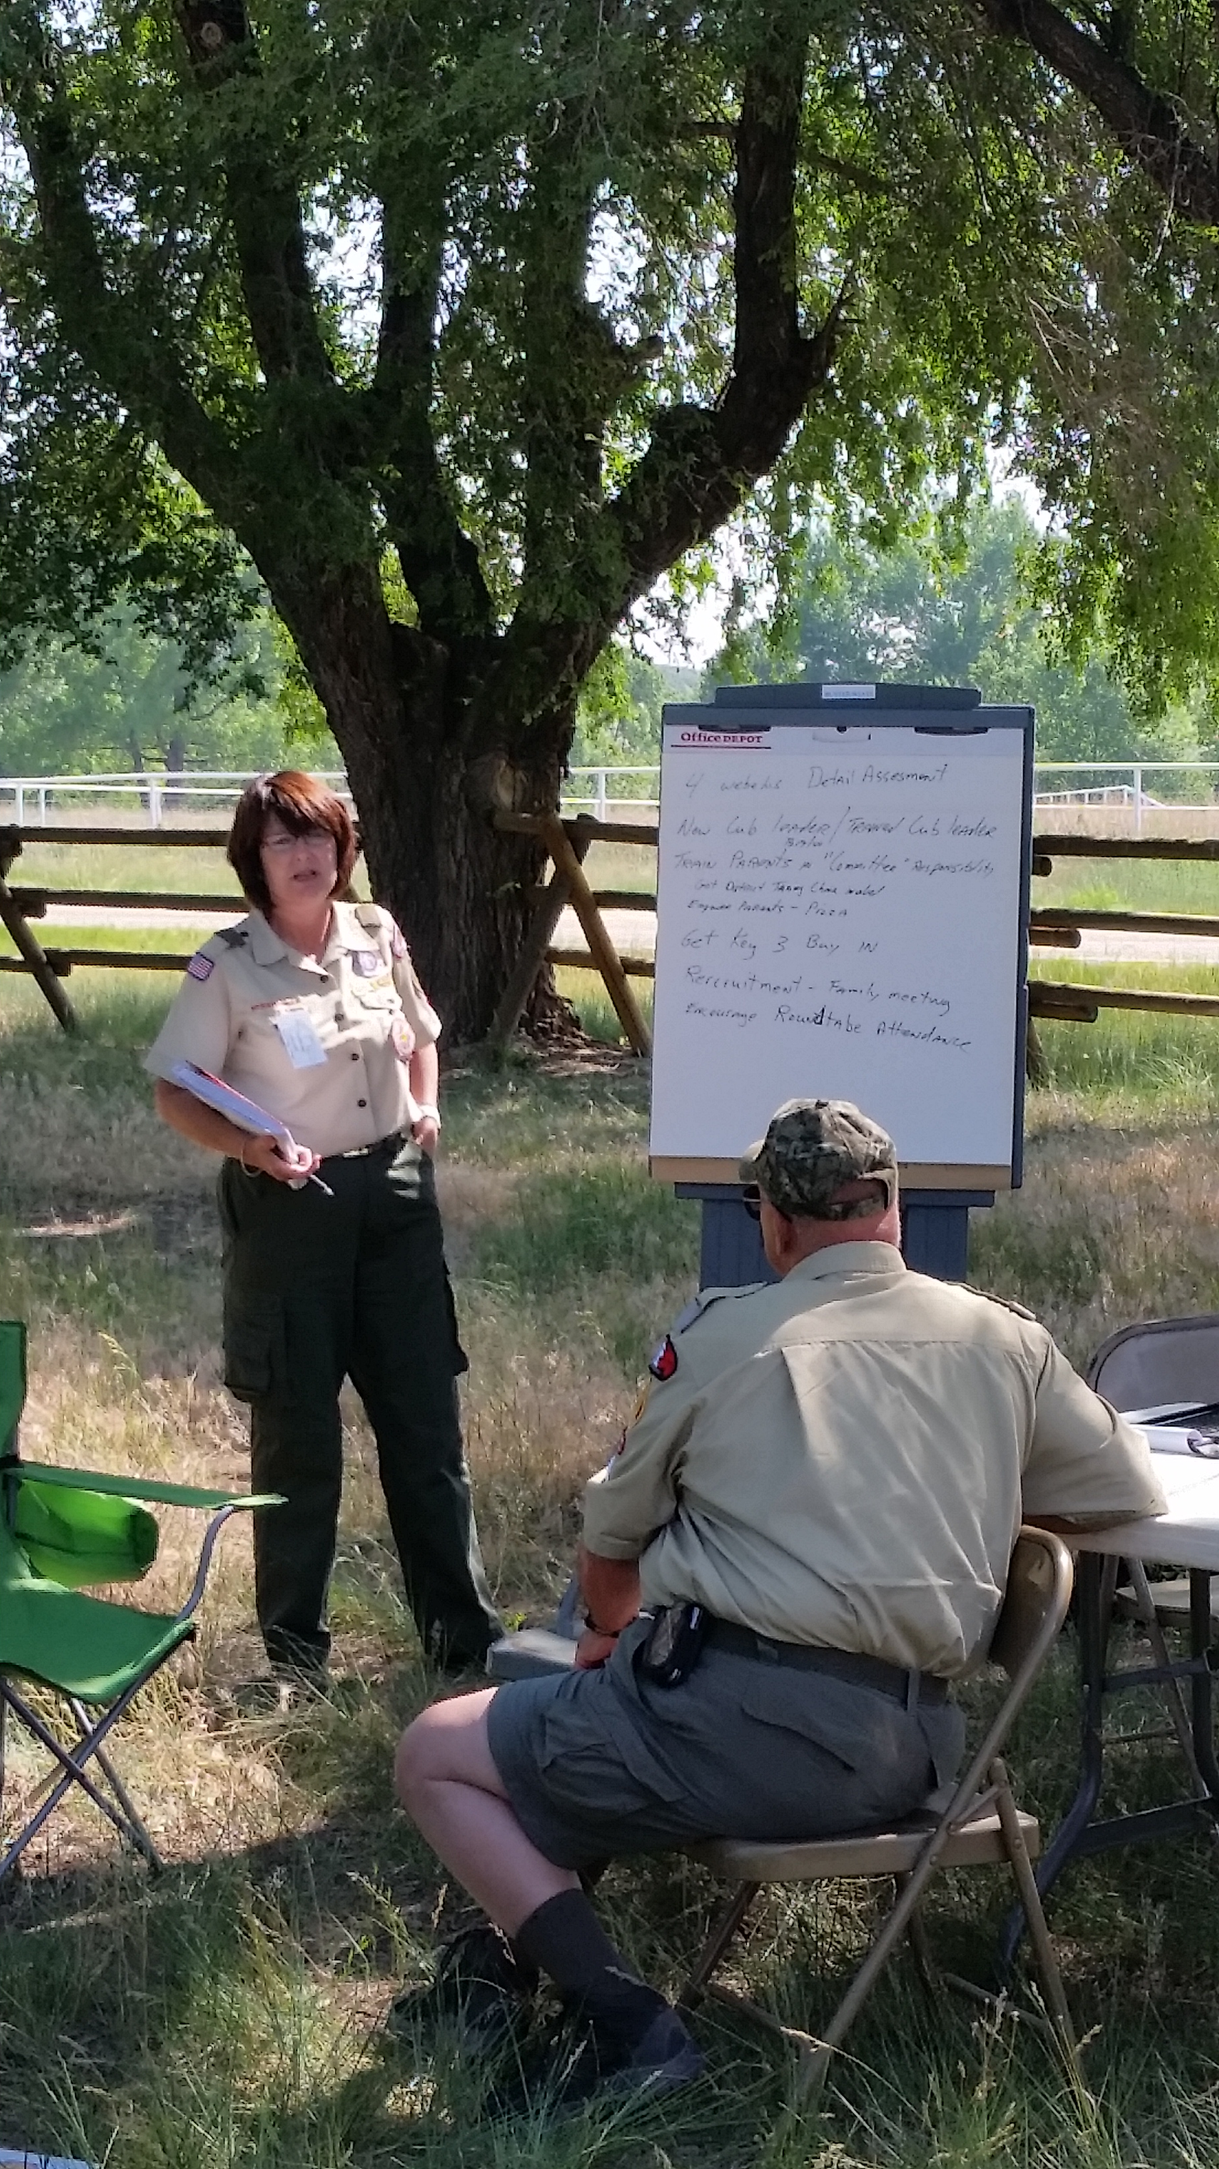
Who Can Benefit from Coaching
New Leaders
Experienced Leaders
Committee Members
Chartered Organizations
Commissioner Team Members
Notes:
As a commissioner you will probably have opportunities to coach leaders thru situations they may not be capable of handling on their own.
Who can benefit from coaching?
Everyone can gain from coaching. In this particular case it would be new leaders, experienced leaders, members of the unit committee and possibly the chartered organization.

Slide 11

When to Consider Coaching
When someone needs encouragement in a difficult task.
When the need for an answer or a solution is isn’t immediate.
When a problem needs to be solved.
Notes:
When to consider Coaching?
When someone needs to be encouraged, a jolt of confidence.
When the need for an answer or a solution is not immediately at hand.
Coaching is especially important when an issue is negatively affecting a unit.
[Ask the class if they can think of a particular situation.]

Slide 12

Coaching offers certain BENEFITS to you as a volunteer leader:
Take time to understand
Demonstrate commitment
Develop skills
Develop effective working relationships
Promote effective change management
Notes:
Take time to understand an issue that is affecting the performance of a volunteer team member.
Demonstrate commitment to support and develop the skills, knowledge and abilities of a volunteer team member.
Develop skills that are valued and transferable across many roles.
Develop effective working relationships with fellow volunteers
Promote effective change management and leadership of problem resolution.

Slide 13
The Coachee BENEFITS include:
Learn to solve their own problems
Improve skills and performance
Learn how to identify and act on development needs.
Have greater confidence and accept responsibility
Develop greater self-awareness and gain new perspectives on ability
Acquire new skills and abilities

Slide 14
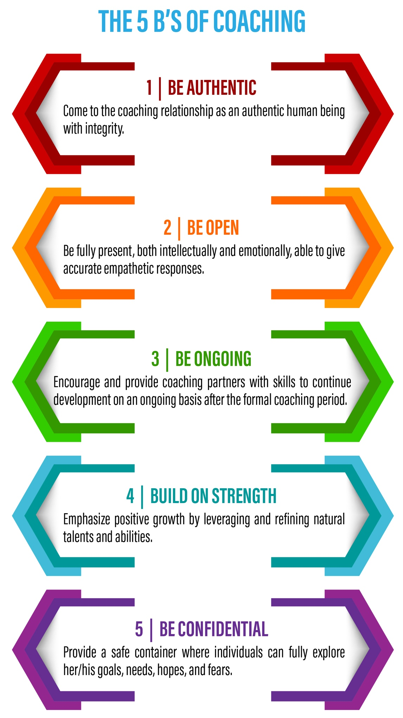
Notes:
The first principle is to be authentic. It is important to come to the coaching relationship as an authentic human being versus a remote impersonal advisor. Since the development of trust is foundational for a productive coaching relationship, coaches should act with integrity, i.e., keep commitments, “walk the talk,” and tell the truth.
The second principle is to be open. It is the responsibility of the coach to be fully present, both intellectually and emotionally, in all contexts throughout the coaching process. The hallmarks of this type of presence are a warm, non-judgmental openness and accurate, empathic responses. This type of presence should characterize both face-to-face encounters as well as contacts over the phone, through e-mail, or by other means.
The next principle is to be ongoing. The coaching process should be conducted in such a fashion that coaching partners are both encouraged and provided with skills to embrace a course of lifelong development not just formal coaching. While the coaching provided should focus on specific goals that can be accomplished during the course of the formal coaching program, the process should also enable individuals to continue their development on an ongoing basis.
Then, the coach should build on strength. While good coaching helps people to address weaknesses, this principle is particularly focused on building upon strengths. Since the coaching relationship is focused on development and not performance management, the emphasis should be on positive growth.
Finally, a good coaching relationship is based on the manager being confidential. Successful coaching relationships depend on trust. The individual being coached needs to feel safe enough in the relationship to fully explore her/his goals, needs, hopes, fears, and withstand an array of feedback from various sources. A key ingredient in building this safe environment is the guarantee of contracted confidentiality. Each coaching relationship should be founded on an agreement between coach and coachee as to the limits of confidentiality in their particular relationship.

Slide 15

Why are Coaching skills important?
Why are Coaching Skills Essential
Provide timely guidance and feedback
Guide and support others to excel
Notes:
Coaching is considered to be a strategy for developing people’s skills, knowledge, and abilities while boosting confidence and performance. Effective coaching can help manage challenges and issues before they evolve into problems. Coaching is beyond corrective action. Coaching is designed to engage people with solutions which they have identified, rather than those imposed by another. It is a proven approach to the identification and achievement of goals through accountability, empowerment, and engagement.
Through the development of coaching skills, leaders can:
Provide timely guidance and feedback to help others strengthen specific knowledge/skill areas needed to accomplish a task or solve a problem.
Guide and support others to excel in their current role and move into higher skills and levels.

Slide 16

Coaching 7 Essential Questions:
The Kickstart Question
The AWE Question
The Focus Question
The Foundation Question
The Lazy Question
The Strategic Question
The Learning Question
Notes:
COACHING SEVEN ESSENTIAL QUESTIONS: (Handout for discussion)
1. The Kickstart Question - What’s on your mind?
2. The AWE Question - And what else?
3. The Focus Question - What’s the real challenge here for you?
4. The Foundation - Question What do you want?
5. The Lazy Question - How can I help?
6. The Strategic Question - If you’re saying Yes to this, what are you saying No to?
7. The Learning Question - What was most useful for you?

Slide 17

Stay Curious, Stay Genuine
Ask It One More Time
Recognize Success
Move On When It’s Time
Notes:
2. The AWE Question - And what else? Three simple words, not one longer than 4 letters. With seemingly no effort, this question creates more - more wisdom, more insights, more self-awareness, more possibilities—out of thin air.
There are three reasons it has the impact that it does:
more options can lead to better decisions; quickest and easiest way to uncover and create new possibilities
you rein yourself in; It’s to see what ideas that person already has (while effectively stopping you from leaping in with your own ideas).
and you buy yourself time.
You do want to remember that the first answer someone gives you is almost never the only answer, and it’s rarely the best answer. You may think that’s obvious, but it’s less so than you realize.
This is Key. As a commissioner you may contacted to visit with members of a unit or a specific issue. When you get there the “Coaching 7 Essentials Questions” are a great way to get a good baseline of the issue. BUT when you ask the AWE Question more underlaying information may bring forward other issues and hopefully the root of the issues with the unit.
When you use “And what else?” you’ll get more options and often better options. Better options lead to better decisions. Better decisions lead to greater success.
Four Practical Tips for Asking “And What Else?”
1. Stay Curious, Stay Genuine
Just because you’ve now got a fabulous question to use, that doesn’t mean you can slip into a bored groove when asking it.
2. Ask It One More Time
As a general rule, people tend to ask this question too few times rather than too many. And the way to master this habit is to try it out and experiment and see what works. As a guideline, I typically ask it at least three times, and rarely more than five.
3. Recognize Success
At some stage of the conversation, someone’s going to say to you, “There is nothing else.” When that happens, a perfectly reasonable reaction is a rapid heartbeat and slight panic. Reframe that reaction as success. “There is nothing else” is a response you should be seeking. It means you’ve reached the end of this line of inquiry.
4. Move On When It’s Time
If you can feel the energy going out of the conversation, you know it’s time to move on from this angle. A strong “wrap it up” variation of “And what else?” is “Is there anything else?” It invites closure, while still leaving the door open for whatever else needs to be said.
If you get three to five answers, then you’ve made great progress. And what else?” is such a useful question that you can add it into almost every exchange.
For example:
-When someone’s told you about a course of action she intends to take, challenge her with “And what else could you do?”
-When you’re trying to find the heart of the issue, and you ask, “What’s the real challenge here for you?” and he offers up a timid or vague or insipid first answer, push deeper by asking, “And what else is a challenge here for you?”

Slide 18

Relationship Building Elements between you and other volunteers:
Develop trust
Mutual respect
Appreciate diversity
Open communication
Be mindful
Get to know them and allow them to get to know you.
Notes:
Develop trust -This is the foundation of every good relationship. When you trust your team and colleagues, you form a powerful bond that helps you work and communicate more effectively. If you trust the volunteers you work with, you can be open and honest in your thoughts and actions.
Mutual respect - When you respect the volunteers that you work with, you value their input and ideas, and they value yours. Working together, you can develop solutions based on your collective insight, wisdom and creativity.
Appreciate diversity - People with good relationships not only accept diverse people and opinions, but they welcome them. For instance, when your friends and colleagues offer different opinions from yours, you take the time to consider what they have to say, and factor their insights into your decision-making.
Open communication - We communicate all day, whether we're sending emails and texts, or meeting face-to-face. The better and more effectively you communicate with those around you, the richer your relationships will be. All good relationships depend on open, honest communication.
Be mindful – Be responsible and practice a deeper level of awareness. Pay careful attention to your words and your actions and don’t let your negative emotions impact people around you.
Get to know them and allow them to get to know you.

Slide 19

A MINDSET is…
A set of assumptions, methods or notions held by one or more people.
A mindset can also be seen as incident of a person's world view or philosophy of life.
A mindset may be so firmly established that it creates a powerful incentive within these people or groups to continue to adopt or accept prior behaviors, choices, or tools.

Slide 20


C.O.A.C.H. Mindset
C.O.A.C.H Mindset
Notes:
The reason for the lighthouse is the following:
Coach’s help individuals steer away from danger just like a light house.
The foundation of the lighthouse is based on the “relationship”.
The best approach to help establish relationships with the leaders in your assigned units is to use this C.O.A.C.H. mindset:
Clarify – Expectations, Needs. Establish level of trust. Be clear on what you want to achieve for yourself and those you coach
Observe – Through Evaluation and Inspection, Conversations and through direct observation.
Ask – Active Listening, being Present and asking questions. – Status, Issue, Impact. Take actions to move forward
Collaborate – Engaging in two-way conversations. Ask more questions. Giving and receiving feedback both supportive and constructive.
Help – Be supportive, authentic, consistent, confidential. Provide resources and always follow up.
Let’s discuss each one.

Slide 21

Clarify
Clarify
Expectations
Needs
Level of Trust
Notes:
Clarify: Expectations and needs, to confirm understanding by both parties. Requires a level of trust.

Slide 22

Observe
Observe
Through Evaluation and Inspection
Through Conversations
Through Direct Observation
Look for Lead Measures (not just lagging indicators)
Give immediate specific feedback
Notes:
Observe:
Through evaluation and inspection
Through having conversations; and
Through direct observations (meetings, listening).
Not just looking at lagging indicators (results). Looking for lead measures.
After they have observed… give immediate specific feedback. This is all for naught, if they don’t help grow the person sharing what they are doing well and what they need to strengthen

Slide 23

Ask
Being Present
Active Listening
Allow Self-Discovery (Root Cause)
Asking Questions
- Status (history)
- Issue (discovery)
- Impact (present state)
Notes:
Ask
Being Present by using Active Listening
Allow volunteers to self discover, or identify the root cause
Asking Questions
- Status (history) questions
- Issue discovery (root cause) questions
- Impact (of the present state) questions

Slide 24

Collaborate
Having trust
Engaging 2 – Way Conversations
Asking More Questions
- Ideal (future state)
- Intention (going forward)
Allow the coachee to self-generate in developing the plan
Notes:
Collaborate: Having trusting, engaging conversations by continuing to ask Ideal (future state) and Intention (going forward) questions. Allowing staff member to self-generate in developing the plan.
Having Trust
Engaging 2 – Way Conversations
Asking More Questions
- Ideal (future state) questions
- Intention (going forward) questions
Allowing staff member to self-generate in developing the plan.

Slide 25

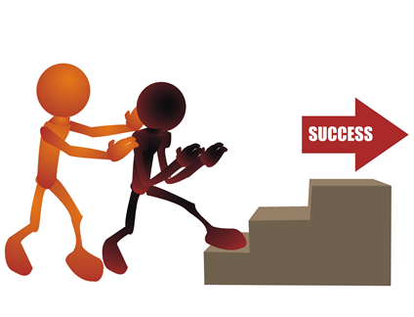
Help
Help
Foundational to the coaching process
Be positive
Be supportive
Be authentic
Be consistent
“Walk the Talk”
Provide resources
Give appreciative and constructive feedback
Always follow up
Notes:
Help
Foundational to the Principle of Coaching
Be positive
Be supportive
Be authentic
Be consistent
“Walk the Talk”
Be confidential
Provide resources
Always follow up
Giving & Receiving Feedback
- Positive & Constructive
Always follow-up

Slide 26

Using the C.O.A.C.H. Mindset
Four Types of Coaching Scenarios
Behavior
Performance
Development
Situational
Notes:
Four Types of Coaching Scenarios
Behavior
Performance
Development
Situational

Slide 27

Behavior Coaching
Consistently late for appointments
Missed deadlines
Easily distracted
Uniform
Notes:
Behavior Coaching
Consistently late
Missed Deadlines
Easily distracted
Uniform – not wearing uniform therefore not setting a good example to others
“I would like to talk with you about…..?”
“It has been brought to my attention that….?”

Slide 28

Performance Coaching
High performer who is highly motivated
Ascending performer
Inconsistent or under performer
Someone who is no longer successful
Notes:
Performance Coaching
High performer who is highly motivated – highly motivated but sometimes at the risk of distancing other leaders
Ascending performer – was a high performer but now is lacking
Inconsistent or under performer – up and down performance and starting to affect unit
Someone who is no longer successful – is no longer performing well as a leader in the unit and is affecting the other leaders and youth
“Something is going on with your performance (ie: cubmaster, scoutmaster, committee chair, other leader) that I do not understand and I am hoping we can talk about it.”

Slide 29

Development Coaching
New assignment/project
Through change
Evaluating skill ability
Notes:
Development Coaching
New unit and or leader
Through change in leadership
Evaluating skill ability – leadership might need changing
Unit growth or possibly a Chartered Partner change
“What are your personal goals in Scouting?”
“What would you like to be doing in 3 to 5 years?”

Slide 30
Situational Coaching
Impromptu – happens at any time. Reinforces, Redirects.
Focuses on timely, more reactive needs, questions, objectives, or challenges.
Typically shorter conversations. Schedule additional time if needed.
Happens in practically every conversation.
Notes:
Situational Coaching (Replicate casual conversation like walking around building)
Impromptu – happens at any time. Reinforces. Redirects.
Focuses on timely, more reactive needs, questions, objectives, or challenges.
Typically shorter conversations. Schedule additional time if needed.
Happens in practically every conversation.
“I just wanted to visit with you about how things are going. Is now a good time or would tomorrow be better?”
“Well done on achieving your JTE goal by _____(date). I wanted to get more details about how the year went, where your unit challenges were and what you would do differently next year. When would be a good time to visit?”

Slide 31

Coaching Scenarios
Notes:
Divide group into teams and role play scenarios (print from course materials). Each team will have a coach, coachee and observer
Have them complete their observations on the coaching feedback form and the debrief with the whole group.
Hand out the C.O.A.C.H. Mindset Preparation Tool as a resource.

Slide 32
Mentoring
Philmont Training Center
Commissioner Week 2019
Mentoring

Slide 33

Mentoring

Slide 34
What is a mentor?
WHAT IS A MENTOR?
Notes:
Ask the group for their thoughts
What is a Mentor?
Have you had a mentor?

Slide 35
What is a Mentor
WHAT IS A MENTOR?
A WISE TEACHER
A GUIDE
A FRIEND

Slide 36
Is Mentoring Like Coaching?
IS MENTORING LIKE COACHING?
Notes:
Ask the group for their thoughts

Slide 37

Is Mentoring Like Coaching
Coaching is the process of facilitating the performance, learning, and development of another person.
Coaching is different from mentoring because the mentoring process is led by the learner and is less skills-based.
Notes:
One description states – coaching is the process of facilitating the performance, learning, and development of another person.
Directing and aligning the members of a team to achieve a goal
Therefore, the coach is also responsible for the development of the team members.
Coaching is different from mentoring because the mentoring process is led by the learner and is less skills-based.

Slide 38
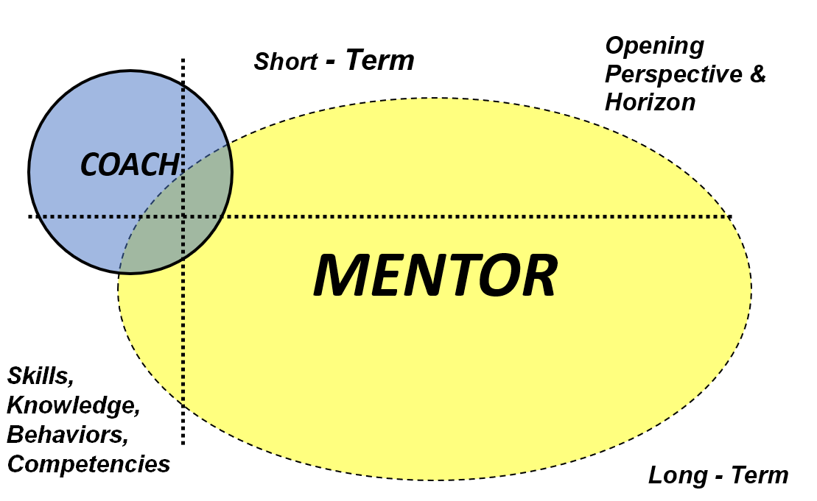
Coaching vs Mentoring
Notes:
This graphic shows how coaching and mentoring intersect, but that mentoring is a long term situation, while coaching is short lived.
Notice the competencies for each.

Slide 39

A Good Mentoring Relationship
Two way relationship
No direct-line relationship
Extra element
Notes:
Identified by the willingness and capability of both parties to ask questions, challenge assumptions, and disagree.
The Mentor is less likely to have a direct-line relationship with the mentee, which is desirable.
Mentoring is rarely a critical part of an individual’s role, but rather an extra element that rewards the mentor with fresh thinking as well as the opportunity to transfer knowledge and experience (wisdom) to a new generation.

Slide 40
Some Key Differences
 | Coaching | Mentoring
Goals | To correct inappropriate behavior, improve performance, and impart skills as an individual accepts a new responsibility | To support and guide the personal growth of the mentee
Initiative | The coach directs the learning and instruction. | The mentee is in charge of his or her learning.
Focus | Immediate problems and learning opportunities | Long-term personal development
Roles | Heavy on telling with appropriate feedback | Heavy on listening, providing a role model, and making suggestions and connections

Slide 41
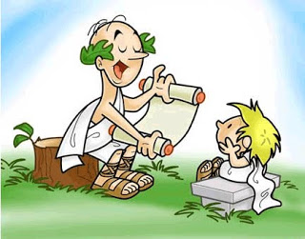
Models of Mentoring
Sponsorship mentoring is a relationship between a mentor and a protégé
Developmental mentoring is less hierarchal and helps the growth of both the mentor and the mentee.

Slide 42

A Scouting Mentoring Relationship
Are mentors assigned?
How do we find them?
How does mentoring happen?
Notes:
This is class discussion

Slide 43

Shape of a Mentoring Relationship
  Will be different
  Evolves over time
  May take and adjust its shape
Notes:
The nature of the mentoring relationship is dynamic, in the sense that it:
Will be different according to the circumstances, purpose, and personalities involved
Evolves over time
May take and adjust its shape along a spectrum defined by two very different philosophies or models of mentoring

Slide 44
What Mentors Do – The MENTOR Model
Mindset: Attitudes, “social intelligence”, and values
Environment: Help understand the unit environment and “culture”
Network: Connect to others who might be able to help
Trust: Trusted, confidential counsel and perspective
Open: Advice, support, and/or guidance on difficult subjects
Retention: Aid in retention of the mentored
Notes:
Mindset: Instills attitudes, “social intelligence”, and values embraced by Scouting
Environment: Help a mentored person develop and understanding of the unit environment and “culture” and the practicalities of life in the unit.
Network: Help connect a mentored person to others who might be able to help them by making introductions or providing recommendations.
Trust: Provide trusted, confidential counsel and a broader perspective on Scouting and personal issues.
Open: Be open for advice, support, and/or guidance on subjects that a young person may find difficult ot discuss with other leaders or peers
Retention: Aid in retention of the mentored individuals in our program.

Slide 45

Tips on Being a Good Mentor
Provide a safe nonthreatening environment
Keep confidences
Build trust early
Be a good listener
Share personal experiences
Ask Questions
Compliment the person
Notes:
Provide a safe nonthreatening environment in which a person can ask difficult or sensitive questions
Keep confidences
Build trust early
Be a good listener
Share personal experiences that address the issues the mentored person is facing
Ask Questions to lead the person to discovering answers and solutions on their own – Use the 7 Essential Questions
Compliment the person on good answers and decisions to problems and issues

Slide 46
Maintaining Relationship Quality
  Goal Clarity
  Rapport
  Boundaries
  Voluntarism
  Basic competencies
  Behaviors of mentee and mentor
  Measurement and review
Notes:
With the mentoring relationship being dynamic and therefore creating a great deal of variation in how individuals approach their roles; however, there are certain factors that will effect the quality of the relationship.
Goal clarity—There needs to be a sense of purpose to the relationship.
The ability to create and manage rapport—It is important that there is an alignment of core values between the mentor and mentee, both in terms of initial attraction or liking and in sustaining the relationship over time. However, partnering individuals with too many similarities can cause problems. The rapport-building process encompasses the skills of accepting and valuing difference as a fundamental learning resource.
Understanding of the role and its boundaries—Clarity must be maintained that the mentor will not assume a directive or managerial role.
Voluntarism—Both participants have to want to be part of the relationship.
Basic competencies on the part of the mentor and mentee—Both parties must bring some skills and attributes to the table. The aim should be to improve these skills over
time through the learning dialogue.
Proactive behaviors by mentee and developmental behaviors by the mentor—The mentee needs to take the initiative and the mentor must not be directive.
Measurement and review—The mentor and mentee need to take time to review the relationship. Having a regular open dialog that focuses on how to improve the
relationship is a key factor. Assess how to make the relationship more valuable and reaffirm the commitment.

Slide 47
Evolution of the Relationship – 5 phases
Phase 1: - Building rapport
Phase 2: - Setting direction
Phase 3: - Progression
Phase 4: - Winding up
Phase 5: - Moving on
Notes:
Phase 1: Building rapport—The mentor and the mentee are exploring if they can work together. They are determining the alignment of values, establishing a mutual respect, agreeing on the purpose of their relationship, and establishing the roles and expectations.
Phase 2: Setting direction—This phase is all about goal setting. Whereas in phase 1, they were establishing a sense of purpose, here they are determining what each of them should achieve through this relationship.
Phase 3: Progression—This phase is longest of the five. Here the both the mentor and mentee become more comfortable about challenging each other’s perceptions, and they explore issues more deeply and experience mutual learning. Also, the mentee takes an increasing lead in managing the relationship and the mentoring process itself.
Phase 4: Winding up—This occurs when the mentee has achieved a large amount of his or her goals. The mentee begins to plan how to continue the journey on his or her own. This helps avoid unhealthy dependency on either individual’s part. Winding up by celebrating the accomplishments is much better than winding down/drifting apart.
Phase 5: Moving on—This is about changing the relationship, often into a friendship where both parties can utilize each other as an ad hoc sounding board.

Slide 48

The Learning Conversation
The point of mentoring is to create a reflective environment where the mentee can address various issues.

Slide 49

Learning Conversation Steps
7 Essential Questions
Reaffirmation
Identify the issue
Building mutual understanding
Exploring alternative solutions
Final check
Notes:
Reaffirmation – The mentor and the mentee spend time to reestablish connectedness using more than just normal social niceties. In a good relationship, there will be a mutual recognition of emotional states and levels of trust.
Identifying the issue – This is when the issue to be discusses is articulated as well as the mentee’s desired outcome is identified. We can use the 7 Essential Questions that we introduced in the Coaching conversation, to get at the heart of the issue
Building mutual understanding – The mentor encourages the mentee to explore the issue in depth, by asking questions that stimulate insight, The 7 Essential Questions. The purpose of the questions is for both of them to understand the situation and all of the elements involved more clearly. The mentor wants to avoid offering solutions or analogies to his or her own experience. When the conversation come to a natural end, the mentor should summarize and check to see if a mutual understanding has been achieved.
Exploring alternative solutions – This is when both the mentor and the mentee allow themselves to be as creative as possible, looking for ways to move forward. The goal is to build a range of solutions from which the mentee will eventually choose to take away for reflection. Using the 7 Essential Questions will lead to some alternatives.
Final check – The mentor encourages the mentee to review what he or she is going to do and why, and what the mentee has learned about both the situation in question and themselves. This allows for a mutual understanding and places the responsibility for what happens next on the mentee.
Between sessions, the mentee should be reflecting on what has been discussed so that they can see if what they have learned relates to other issues.
The mentor should also reflect upon his or her role in the relationship so that the relationship’s progress can be measures.

Slide 50
7 Essential Questions Revisited:
The Kickstart Question
The AWE Question
The Focus Question
The Foundation Question
The Lazy Question
The Strategic Question
The Learning Question
Notes:
SEVEN ESSENTIAL QUESTIONS – We can use the same tool we used in Coaching to get at the heart of the mentee-mentor task(s).
1. The Kickstart Question - What’s on your mind?
2. The AWE Question - And what else?
3. The Focus Question - What’s the real challenge here for you?
4. The Foundation - Question What do you want?
5. The Lazy Question - How can I help?
6. The Strategic Question - If you’re saying Yes to this, what are you saying No to?
7. The Learning Question - What was most useful for you?

Slide 51
Benefits of Mentoring
For the mentee
  Improved knowledge and skills
  Greater confidence and well-being
For the mentor
  Greater satisfaction
  New knowledge and skills
  Leadership development
For Scouting
  Improved morale, motivation, and relationships

Slide 52

Key Findings
Mentoring is not Coaching
Mentoring in Scouting happens organically
Key to mentoring is the relationship
Mentoring is a 2 way street
Mentoring can be a sustainable relationship

Slide 53
Coaching and Mentoring
Philmont Training Center
Commissioner Week 2019

